Slide 1
Stock Market Future Price Prediction
A Data-driven Approach to forcasting Stock Prices
Hardik Lakkad

Slide 2
Objective
We proposed to develop a system that pridicts future stock price based on historical data and pattern
Value Proposition
A well-develop model prediction can help investors improve an investment strategies and portfolio management by 10%-15%
A small improvement in prediction model can a lead significant gain for investors and financial institutions.

Slide 3
Key Areas
Market Trends
Risk Management
01
04
Predictive Modeling
Emerging Technologies
02
05
Factors Influencing Stock Prices
Global Economic Landscape
03
06

Slide 4
Timeline for MVP( Minimum Viable Product)
01
02
03
Data Gethering and Preprocessing
(2 week)
Data Analysis for key insight
(1 week)
Model Selection and Initial Setup
(1 week)
04
05
06
Model Training and Optimization
(1 week)
Model Evaluation and Validation
(1 week)
Deployment and Final Review
(2 week)

Slide 5
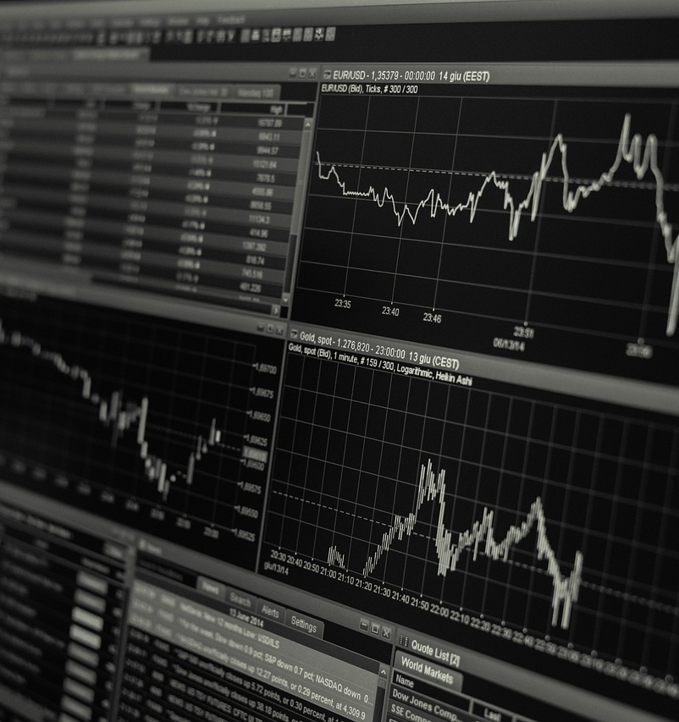
Key Performance Indicators (KPIs)
1. Prediction Accuracy
2. Profit/Loss Impact
3. User Adoption
4. Return on Investment

Slide 6
Resource Requirements
Team Members
Technical
Resources
Business
Support
Data Scientist
Financial Analyst
Software Developer
Historical Data
Real Time Data
Cloud Support
Collaboration With Finance Team
IT Team

Slide 7
Conclusion
Our stock price prediction model has the potential to improve investment decisions by leveraging machine learning technology.
With an 8-week timeline and minimal resource requirements, we can deliver a function MVP to test the model.

Slide 8
Questions and Discussion

Slide 9



Historical Patterns
Analyze Past Trends
Identify Cyclical Behavior
Forecast Future Movements
Examine historical market data to identify recurring patterns.
Recognize cyclical fluctuations in stock prices over time.
Use historical patterns to predict potential future market movements.

Slide 10

Economic Indicators
Inflation Rates
GDP Growth
Interest Rates
Monitor changes in consumer prices.
Analyze overall economic performance.
Observe monetary policy adjustments.

Slide 11
Investor Sentiment
Analyzing Market Mood
Tracking Sector Performance
Interpreting Economic Indicators
Monitoring consumer confidence and market volatility to gauge investor sentiment.
Identifying industry trends that may influence future stock prices.
Assessing macroeconomic data to understand the broader market context.

Slide 12
Predictive Modeling
PART 02
Add description

Slide 13

Machine Learning Techniques
01
Regression Analysis
02
Decision Tree Algorithms
03
Neural Networks
Utilize regression models to forecast future stock prices.
Leverage decision tree classifiers to identify market trends.
Apply deep learning neural networks for price prediction.

Slide 14



Time Series Analysis
01
02
03
Forecasting Future Trends
Identifying Patterns
Seasonal Adjustments
Analyze historical stock price data to predict future movements.
Recognize recurring patterns in stock market fluctuations.
Account for seasonal factors that influence stock prices.

Slide 15
Scenario Planning
Analyze Historical Trends
Examine past stock market data to identify patterns and trends.
Simulate Market Conditions
Create models to simulate different economic scenarios.
Forecast Future Prices
Use predictive analytics to estimate future stock prices.

Slide 16
Factors Influencing Stock Prices
PART 03
Add description

Slide 17
Macroeconomic Conditions
Economic Growth
Interest Rates
Investor Sentiment
GDP, employment, and inflation impact stock prices.
Changes in interest rates affect stock valuations.
Optimism or pessimism influences stock market performance.

Slide 18

Industry Dynamics
Economic Indicators
Analyze macroeconomic trends affecting industry.
Competitive Landscape
Evaluate competitor strategies and market share.
Regulatory Environment
Understand impact of government policies on industry.

Slide 19
Company Performance
01
02
03
Earnings Reports
Economic Conditions
Competitive Landscape
Analyze company's financial statements and earnings.
Assess macroeconomic factors affecting the industry.
Evaluate competitors' strategies and market share.

Slide 20
Risk Management
PART 04
Add description

Slide 21

Portfolio Diversification
Mitigate Risk
Optimize Returns
Enhance Stability
Spread investments across different asset classes to reduce overall portfolio volatility.
Combine low-correlated assets to enhance risk-adjusted returns.
Diversify to create a more stable and resilient investment portfolio.

Slide 22
Hedging Strategies
01
02
03
Diversification
Options Trading
Futures Contracts
Investing in a variety of assets to mitigate risk.
Using options contracts to protect against price fluctuations.
Locking in future prices to manage market volatility.

Slide 23
Volatility Forecasting
Analyze Historical Trends
Examine past market volatility to identify patterns and potential risks.
Utilize Statistical Models
Apply advanced statistical techniques to forecast future market volatility.
Implement Risk Mitigation Strategies
Develop plans to manage and minimize the impact of market volatility.

Slide 24
Emerging Technologies
PART 05
Add description

Slide 25
Blockchain and Cryptocurrencies
Decentralized Transactions
Cryptocurrency Adoption
Smart Contract Applications
Blockchain enables secure, transparent, and decentralized financial transactions.
Rising popularity of digital currencies like Bitcoin and Ethereum.
Blockchain-based smart contracts automate complex financial agreements.

Slide 26

Artificial Intelligence
Machine Learning
Natural Language Processing
Computer Vision
Leveraging advanced algorithms to analyze market data and identify patterns.
Extracting insights from financial news and reports to inform investment decisions.
Analyzing market trends and indicators through visual data analysis.

Slide 27
Internet of Things
01
02
03
Sensor Integration
Cloud Computing
Predictive Analytics
Connecting physical devices to the internet for data collection.
Leveraging cloud platforms for data storage and processing.
Utilizing AI and ML to forecast stock market trends.

Slide 28
Global Economic Landscape
PART 06
Add description

Slide 29
Geopolitical Tensions
01
Evolving Global Dynamics
02
Emerging Market Volatility
03
Regulatory Landscape Shifts
Analyzing the impact of geopolitical factors on stock market trends.
Assessing the influence of geopolitical events on emerging market performance.
Evaluating the regulatory changes driven by geopolitical tensions.

Slide 30
Trade Policies
Emerging Trends
Geopolitical Factors
Regulatory Changes
Analyzing the impact of evolving trade policies on global markets.
Examining how geopolitical tensions influence trade and investment decisions.
Identifying regulatory shifts that may affect stock market performance.

Slide 31
Currency Fluctuations
Analyze Currency Trends
Examine historical currency exchange rate patterns and identify potential future fluctuations.
Assess Macroeconomic Factors
Evaluate how global economic conditions impact currency values.
Leverage Predictive Analytics
Utilize data-driven models to forecast future currency price movements.

Slide 32
Thank You
Name

